Slide 1
Machiavelli: The Prince 2
Virtu, Fortuna, and Power

Slide 2
Today
Fortuna
Virtu
Constraints/power of the people
New political morality
Advice for princes
The Liberation of Italy
In all of these, watch for the presence and/or subversion of Roman and Christian ideas

Slide 3
Fortuna

Slide 4
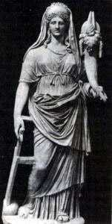
Roman Fortuna
Roman (and Greek) goddess of fate
Depicted as large/larger than men, with cornucopia and rudder
Dispenses wealth, power, and glory
Changeable in her favours
But favours the brave and those with courage

Slide 5
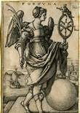
Christian Fortuna
Wheel of fortune
Capricious, fickle
Cruel and without pity
Dispenses worldly goods
True aim – ignore fortune’s gifts and thefts, as they are transient and ultimately unimportant

Slide 6
Machiavelli’s Fortuna
‘Fortuna is a woman’
Changeable – cannot rely on her favour over time (ex. Borgia)
Fortuna will ruin those of constant temperament, for they do not change as she requires.
How best to cope with Fortuna:
- Can anticipate and prepare for changes in fortune , e.g. ‘building embankments’
- Bold and impetuous action will more likely win her favour
- ‘beat and struggle with her’ ‘command her with audacity’
‘Fortuna is the arbiter of one half of our actions, but she leaves the control of the other half, or almost that, to us.’

Slide 7
Virtu

Slide 8
Roman ideas of virtus (vir)
Roman virtus
Roman princely virtus
Manliness - in contrast to the behaviour of beasts, in particular:
Lion – Force
Fox - Fraud
(Cicero, De Officiis)
Cardinal virtues: wisdom, justice, courage, temperance (Cicero)
‘Princely’ virtues: honesty/fair dealing, magnanimity and liberality (Cicero & Seneca)
Honour and glory results from consistent virtuous behaviour
Ultimately all rational behaviour must be moral. (non-moral expediency is an illusion)

Slide 9
Machiavelli’s virtu
Virtue on its head, subverted
‘Well aware that others have written on this subject…[but] what I have to say differs from the precepts offered by others’
No official definition but generally taken to be political skill or effectiveness, strategic thinking, forcefulness, foresight, decisiveness, ruthlessness .
A wise prince does good when he can, but when necessary ‘ he must be prepared to act in the opposite way.’

Slide 10
In particular
Generosity /liberality – generosity, (especially at first) is to be avoided, and ultimately creates unpopularity (taxation, expectations)
Mercy/magnanimity/clemency – Avoid creating a reputation for clemency, which seems weak and undermines respect
‘ Better to be feared than loved’ Ideally both, but difficult to join them together.
And finally – be prepared to be both a lion and a fox when necessary (Fierce and cunning)

Slide 11
Honesty/fair dealing:
‘ A wise ruler, therefore, cannot and should not keep his word when such and observance of faith would be to his disadvantage and when the reasons which made him promise are removed. And if men were all good, this rule would not be good; but since men are a sorry lot and will not keep their promises to you, you likewise need not keep yours to them’
Personal vices:
‘A Prince must be prudent enough to know how to escape….those vices that would lose the state for him, and ……he need not concern himself unduly if he ignores these less serious vices.’

Slide 12
Virtue, virtu, and Fortuna
Traditional virtues (e.g. generosity, mercy, honesty) rejected
Virtu has a fundamentally different character - adaptable rather than fixed (as in Aristotle)
Relationship with Fortuna distinctly different than either Roman or Christian views. Virtu follows Fortuna

Slide 13
However…..
Indiscriminate cruelty or cruelty for its own sake to be avoided. Cruelty judiciously employed should be necessary, applied early and with minimal force. Excessive cruelty precludes glory.
Must at all costs avoid the contempt and hatred of the people. Avoid the usurpation of property or women. Avoid being seen as ‘changeable, frivolous, effeminate, cowardly or irresolute.’
How?

Slide 14

New ‘political morality’
Crucial to ‘ appear’ to be good and to ‘cunningly confuse men’
‘Therefore it is not necessary to have these (virtues), but it is very necessary for him to appear to have them.’ (XVIII)
‘Furthermore…having and practising them at all times is harmful, while appearing to have them is useful.’(XVIII)
First articulation of the nature and rationale for ‘Spin’
- or ‘post-truth politics’

Slide 15
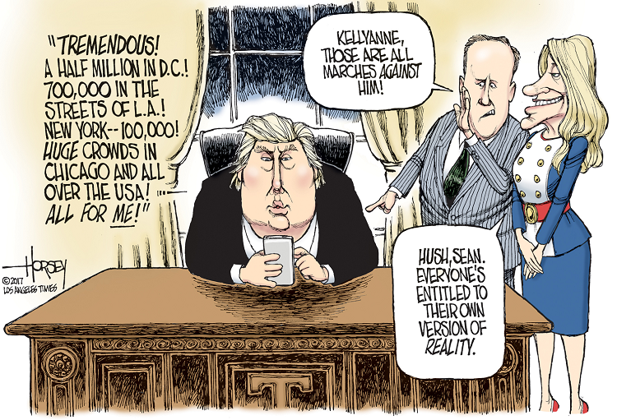
Fake news

Slide 16
‘Those things for which rulers are praised or blamed’
Praised
Blamed
Acts with virtu /appears to act with virtue
Anticipates and adapts to fortune
Feared and respected
Judicious cruelty
Consistently acts with cruelty
Consistently acts with virtue.
Hated/scorned
Consistent behaviour regardless of circumstances
Overly generous and/or merciful

Slide 17
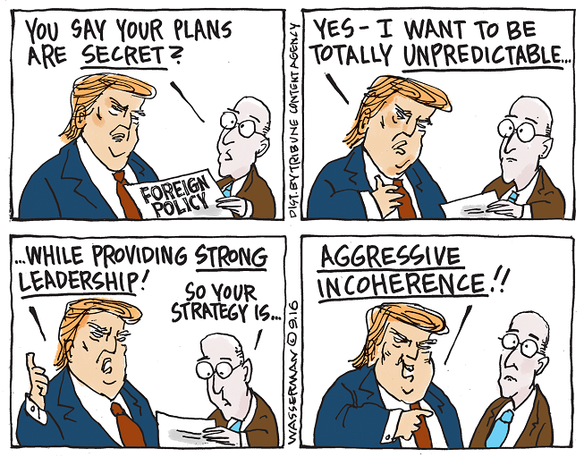

Slide 18
The great prince
Practices virtu rather than virtue
Anticipates and prepares for changes in fortune
Prepared to do what is necessary to take advantage of occasionne and Fortuna’s favour
Acquires and maintains power
Leaves a legacy of glory ……and perhaps the founding of a great state.

Slide 19
The Liberation of Italy
Italy ‘ remains without life and awaits the man who can heal her wounds ‘ …. ‘and redeem her from barbarian cruelties.’
The times are suitable for a new Italian prince from an ‘illustrious house’ who can exercise skill and prudence and follow the examples and advice herein in taking up this mission’
This opportunity for Italy to behold her redeemer must not pass by….

